Slide 1
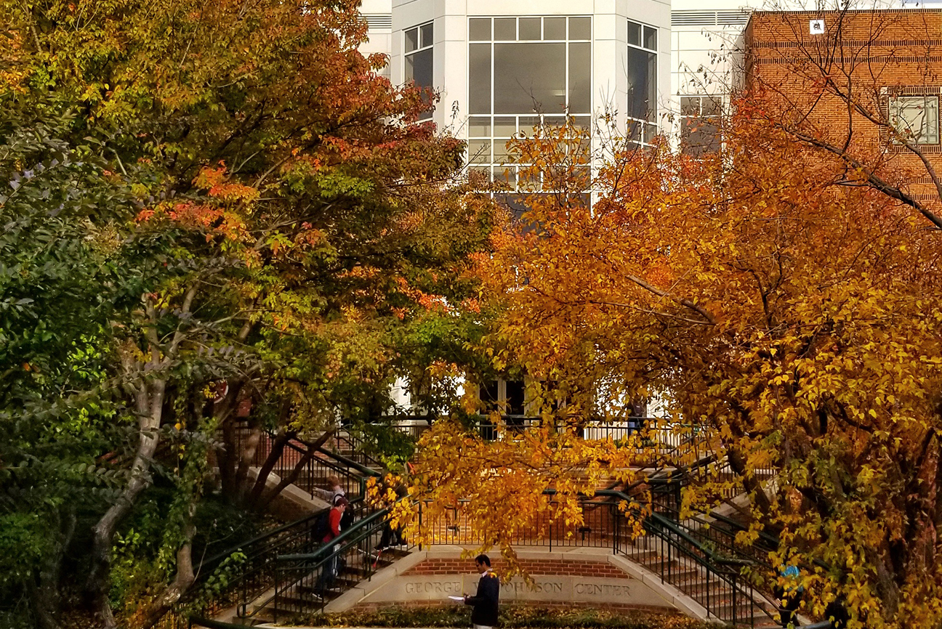

George Mason CSI PhD,
Developing Uncertainty Aware Digital Twins for Indoor Air Quality Modeling, Analysis,
and Decision Support
Adam Seybert (Lieutenant Colonel, US Army)
George Mason University, US Army Student Detachment

Slide 2
Agenda
Introduction and Motivation
Related Work
Research Questions and Objectives
Proposed Approach
Expected Contributions and Impacts

Slide 3
Introduction and Motivation

Slide 4

Introduction and Motivation
Indoor air quality (IAQ) directly impacts human health and productivity, yet is often poorly understood or managed in real-time.
Majority of time spent indoors, exposed to airborne contaminants
Over 3 million premature deaths each year from diseases caused by household air pollution [WHO, 2020]
Advanced HVAC systems create complex and building-unique spatial and temporal air-flow dynamics
Notes:
The purpose of this presentation is to present a proposed innovative method to advance the state-of-the-art in DT sciences—specifically related to dynamic uncertainty quantification and analysis.
However, before we begin, I’d like to briefly present the contextual setting for a DT application domain.
\cite{brancoReviewParametersIAQ2024}
\cite{rajagopalanYearIAQMonitoringScools2022}
\cite{ASHRAEiaq2023}
\cite{ASHRAEiaqGuide2009}

Slide 5
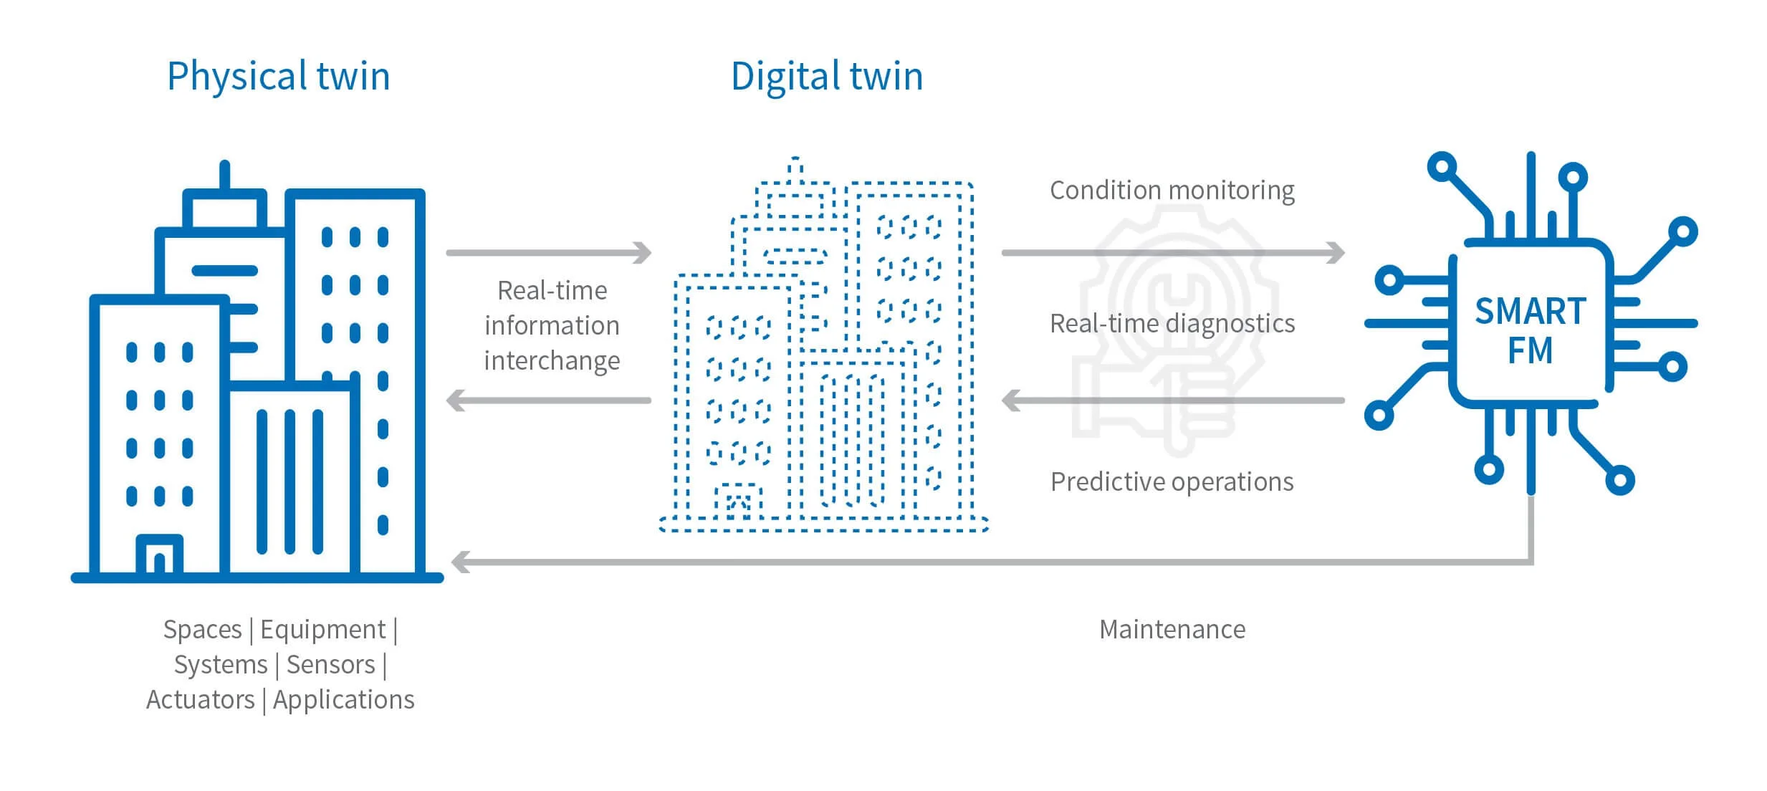
Introduction (cont.)
Digital twins (DTs) are a promising framework for monitoring, simulation, and control of complicated systems including indoor environments
Uncertainty is inherent in DT systems
Uncertainty is not static and evolves as data, models, and decision evolve to mirror physical systems
https://www.pressac.com/insights/what-is-a-digital-twin-and-how-can-it-be-used-for-smart-facilities-management/
There is a critical need for uncertainty-aware digital twins that can track, attribute, and budget uncertainty in time-varying systems.
Notes:
In the Department of Defense, CBRN Threat Modeling and Measuring are often separate operations and not integrated missions.
DTs help bridge that gap

Slide 6
Opportunities for IAQ
Emerging Opportunities: The convergence of high-fidelity building models, internet-of-things sensors, and advanced AI/ML methods provides opportunities to advance the state-of-the-art in real-time indoor IAQ modeling and analysis
Digital-Twins
Building Information Modeling
Mathematical foundations research
IOT Sensors (Industry 4.0)
Low-cost
Networked
Standardized
AI/ML Methods
Bayesian methods
Kalman filters
Ensemble methods
Gaussian Process Regression
https://www.pressac.com/insights/what-is-a-digital-twin-and-how-can-it-be-used-for-smart-facilities-management/
“As the foundations of digital twins are established, it is the ideal time to examine the architecture, interfaces, bidirectional workflows of the virtual twin with the physical counterpart, and community practices in order to make evolutionary advances that benefit all disciplinary communities.”

Slide 7
Literature Review

Slide 8
Literature Review -- Scope
Indoor Air Quality Modeling
Digital Model/
Digital Shadow/
Digital Twin
Definitions and Evolutions
Elements of DT Systems
Core Technologies
Applications
Challenges and Future Directions
Source
Term Estimation
Uncertainty Analysis and Quantification
Definitions and Descriptions
IAQ Modeling Approaches
Applications (STE)
Challenges and Future Directions
Types of Uncertainty
Approaches
Applications
Integration concepts
Challenges and Future Directions

Slide 9
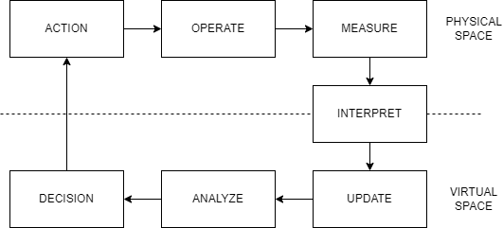
Literature Review-Major Conclusions
Digital Twin (DT) Technologies
Components
Modeling and Simulation to create a virtual representation of a physical counterpart
Bi-directional interaction between the virtual and physical
DTs offer a promising advancements by:
Integrating real-time sensor data
Applying data assimilation techniques
Using advanced simulation models
This integration can:
Optimize the physical system processes
Enhance the precision of system predictions
Reduce related uncertainties
Digital Twins for Decision Support
Eric VanDerHorn and Sankaran Mahadevan. Digital twin: Generalization, characterization and implementation. Decision Support Systems, 145:113524, 2021.

Slide 10
DT Uncertainty Challenges
However… Digital Twins cannot remove all uncertainty
Sensor Inaccuracies: Measurement errors, noise, calibration drift, and environmental interferences, reducing the reliability of model updates.
Parameter Uncertainty: Uncertainty in critical model inputs can arise from limited data or assumptions, impacting the accuracy of simulations and predictions.
Model-Form Errors: Simplifications, missing physics, and incorrect assumptions in the model structure can cause discrepancies between the DT and the real-world system.
Environmental Variability: Changes in outdoor air quality, weather, occupancy, and human activities introduce unpredictable variability that inherently limits the precision of digital twin forecasts.
Notes:
As my literature review demonstrates, there are many practical challenges to implementing DTs.
One of the most challenging is handling uncertainty

Slide 11
Literature Review Highlights – UQ-DT
UQ is essential for reliable and robust digital twins.
Uncertainty Sources Include:
Sensor Inaccuracies, Parameter Uncertainty, Model-Form Errors, Environmental Variability.
DT uncertainty is time-dependent
Reduces trust in DT outputs and must be continuously assessed
Time dependency based on:
Transient operational conditions (short term)
Evolving (degrading) performance, system changes, lifecycle (long term)
Design
Operations
End-of-life

Slide 12
Problem Statement
Digital twins are evolving, instance-specific models that support real-time decision-making but cannot be validated immediately, introducing a unique form of uncertainty due to delayed validation. This challenge demands new methodologies to quantify and manage uncertainty over time—particularly under changing operational conditions—so that decisions can remain reliable even when model validation lags behind.
Digital Twins are complicated systems
Must understand uncertainty of all parts
Must understand how uncertainty propagates (and builds)
Must understand how uncertainty impacts decision making
Digital Twins are dynamic systems
UQ methods must also be dynamic
Digital Twins are instance specific
Population-based validation is less reliable

Slide 13
Research Questions and Objectives

Slide 14
Research Questions
Research Questions: What strategies can be employed to budget uncertainty (dynamic validation metrics) across different sources (e.g. sensor noise, parameter variability, model-form error, environmental variability) in a time-dependent manner.
RQ1: How do different sources of uncertainty—such as sensor noise, model-form error, parameter variability, and environmental dynamics— impact DT?
Impacts to parameter estimation
Impacts to model simulations
Impacts to decision/action models

Slide 15
Research Questions
Research Questions: What strategies can be employed to budget uncertainty (dynamic validation metrics) across different sources (e.g. sensor noise, parameter variability, model-form error, environmental variability) in a time-dependent manner.
RQ2: What computational methods (e.g., variance-based decomposition, sensitivity analysis) are most effective for quantifying, attributing, and tracking uncertainty contributions over time in DT?
What are the general methods for dynamic UQ?
What aspects of DTs complicate general dynamic UQ methods?
How can these challenges be overcome?

Slide 16
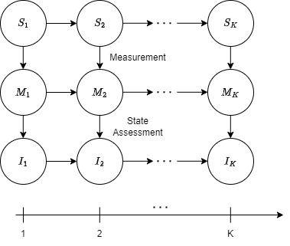
$${\text{State} \text{transition}\text{: } S}_{k}=f\left(S_{k−1}, u_{k−1}\right)+ ω_{k}$$
$${\text{Measurement}\text{: } M}_{k}=g\left(S_{k}\right)+ v_{k}$$
$${\text{Model} \text{Parameter}\text{: } I}_{k}=h\left(M_{k}\right)+ τ_{k}$$
${\text{State}\text{, }\text{Measurement}\text{, }\text{and} \text{Parameter} \text{vectors}\text{: } S}_{k}$, $M_{k}$, $I_{k}$
$\text{State}\text{, }\text{Measurement}\text{, }\text{and} \text{Parameter} \text{functions}\text{: }f(∙)$, $g(∙)$, $h(∙)$
$\text{P}\text{rocess} \text{noise}\text{, }\text{measurement} \text{noice}\text{, }\text{and} \text{parameter} \text{error}\text{:}$ $ω_{k}$, $v_{k}$, $τ_{k}$
$\text{V}\text{irtual} \text{Model} \text{Uncertainty}\text{: }U_{k}= ζ(ω_{k}$, $v_{k}$, $τ_{k}$)
Adapted from Thelen Part 1
Notes:
\cite{thelen}

Slide 17
Research Questions
Research Questions: What strategies can be employed to budget uncertainty (dynamic validation metrics) across different sources (e.g. sensor noise, parameter variability, model-form error, environmental variability) in a time-dependent manner.
RQ3: How can evolving uncertainty budgets be translated into actionable insights for sensor placement, model refinement, and risk-aware decision-making?
What categories of decisions do DTs support?
What DT decisions/actions can reduce uncertainty?

Slide 18
Research Objectives & Questions
Primary Objective: Develop and evaluate a comprehensive framework for constructing uncertainty-aware DTs that can dynamically quantify, manage, and reduce uncertainty in real-time.
Specific Objectives:
1. Uncertainty Sources: Identify and categorize the key sources of uncertainty in DT systems, with a focus on sensor data errors, model-form limitations, parameter variability, and environmental dynamics.

Slide 19
Research Objectives & Questions
Primary Objective: Develop and evaluate a comprehensive framework for constructing uncertainty-aware DTs that can dynamically quantify, manage, and reduce uncertainty in real-time.
Specific Objectives:
2. Computational Method Development: Develop and evaluate computational techniques—such as variance-based decomposition and sensitivity analysis—along with a methodology for evaluating the most appropriate techniques based on the dynamic validation metrics of time-dependent DT models.

Slide 20
Research Objectives & Questions
Primary Objective: Develop and evaluate a comprehensive framework for constructing uncertainty-aware DTs that can dynamically quantify, manage, and reduce uncertainty in real-time.
Specific Objectives:
3. Case Study Evaluation: Evaluate the performance of the proposed uncertainty-aware DT framework through simulation-based case studies using the CONTAM multi-zone model for IAQ, comparing its predictive accuracy and robustness to conventional DT and non-DT approaches.

Slide 21
Proposed Approach

Slide 22
Methodology
Uncertainty Sources (Taxonomy)
Uncertainty-Aware Methodology
Applications in an IAQ Case Study

Slide 23
Uncertainty Taxonomy
Uncertainty Sources
Source 1
Risk to Decision Making
Risk 1
Quantification Methods
UQ1
UQ2
Reduction Methods
RM1-1
RM1-2
RM2-1
Implementation Costs
C1-1
C1-2
C2-1
Notes:
Except for evaluating risk and cost to implement, this is the uncertainty taxonomy presented in Thelen (2022). This work will examine how this taxonomy, with associated cost and risk can fit in an uncertainty budget.

Slide 24
DT Feedback Loop

Slide 25
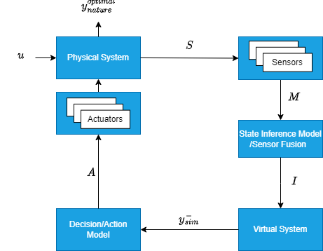
DT Feedback Loop

Slide 26
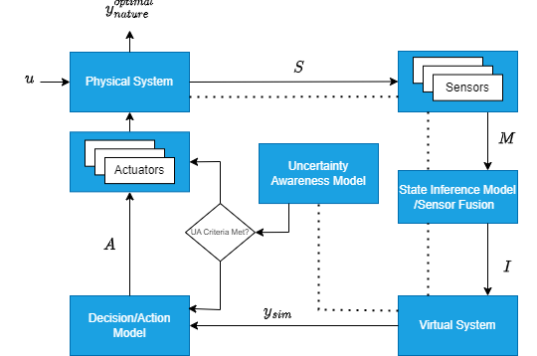
Uncertainty Aware Feedback Loop
no
yes

Slide 27
Uncertainty Awareness Model
Uncertainty Awareness Model
Uncertainty Awareness Metrics
Decisions to be made considering uncertainty
Control
Optimization
Decision/Actions to reduce uncertainty
Sensor steering
Low to high-fidelity model flipping
Quantification of Uncertainty
Time Dependent
Multiple quantities of interest
Computational considerate
Global Sensitivity Analysis demonstrates promise
Quantifiable
Explainable

Slide 28
Indoor Air Quality Case Studies
Use NIST Reference residential buildings as the physical system
Use surrogate data
Sensor-representative contaminant data
Environmental data (weather, exterior contaminants)
Building air-flow-path variability
Simple HVAC schedules and control
CONTAM Multi-zone model as virtual model
Scenario should include
Transient contaminant releases
Periodic building air-flow dynamics
Sensor, controller, and ventilation faults

Slide 29
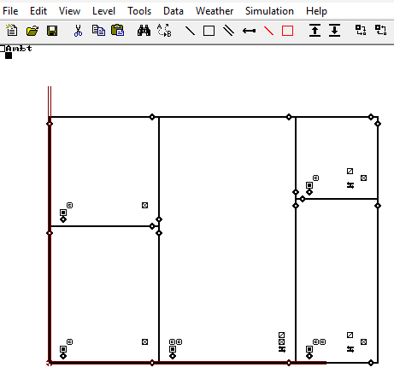
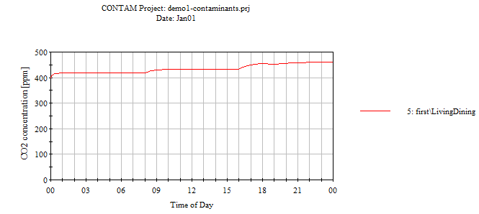
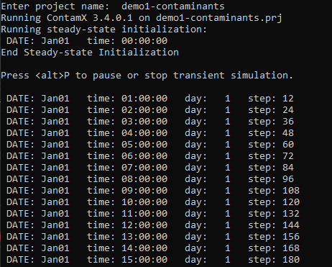
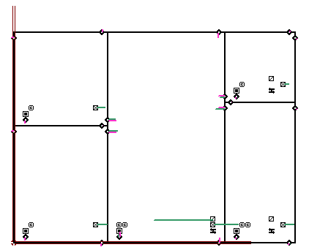
Running studies with CONTAM
CONTAM-W
Build project file
CONTAM-X
Simulation Engine
View results
Python Parameter and Results Scripting
Notes:
Annimation to build with python parameter and results scripting

Slide 30
Running studies with CONTAM
CONTAM-W
Build project file
CONTAM-X
Simulation Engine
View results
Python Parameter and Results Scripting
Notes:
Annimation to build with python parameter and results scripting

Slide 31
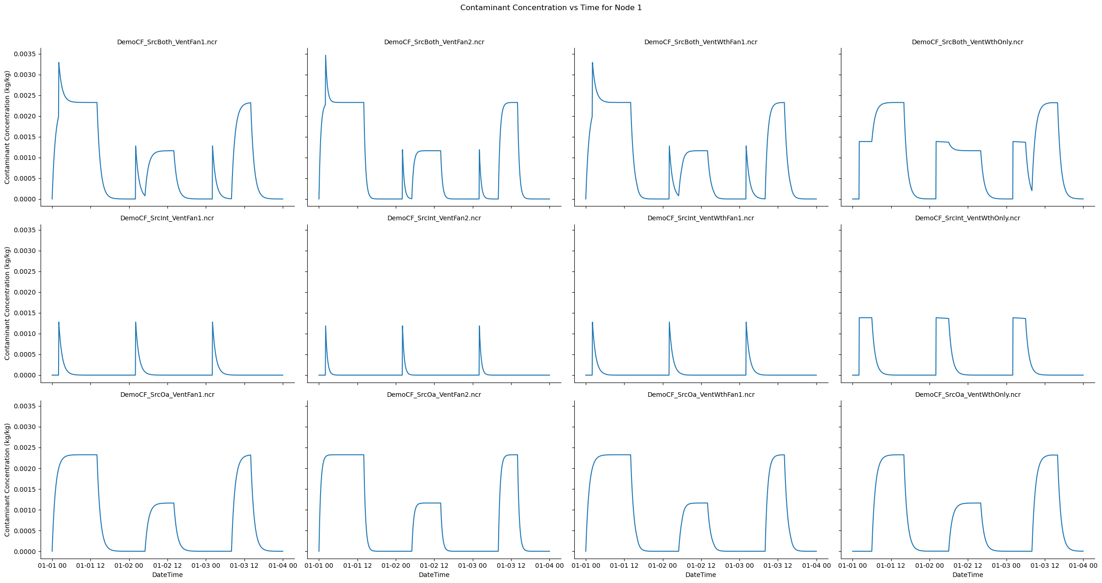
Multi-simulation Results
Notes:
12 different scenarios
Y-axis is source considerations (exterior source and interior, exterior only, interior only)
X-axis is control scenarios (fan 1, fan 2, weather and fan 1, weather only)

Slide 32
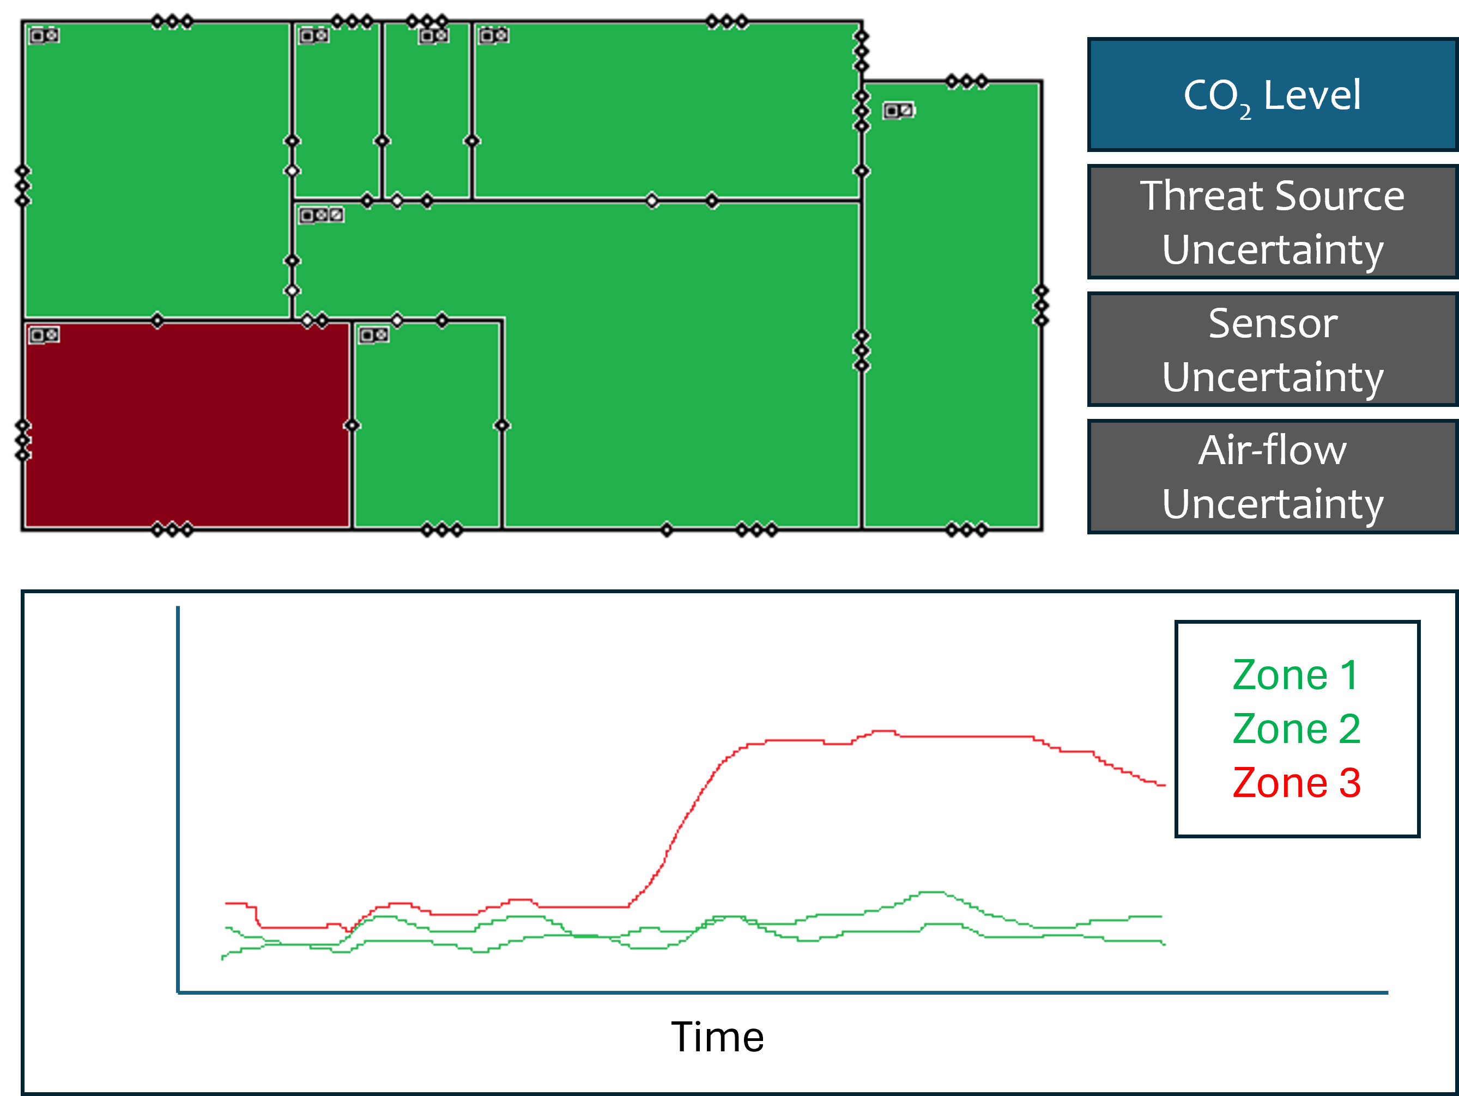
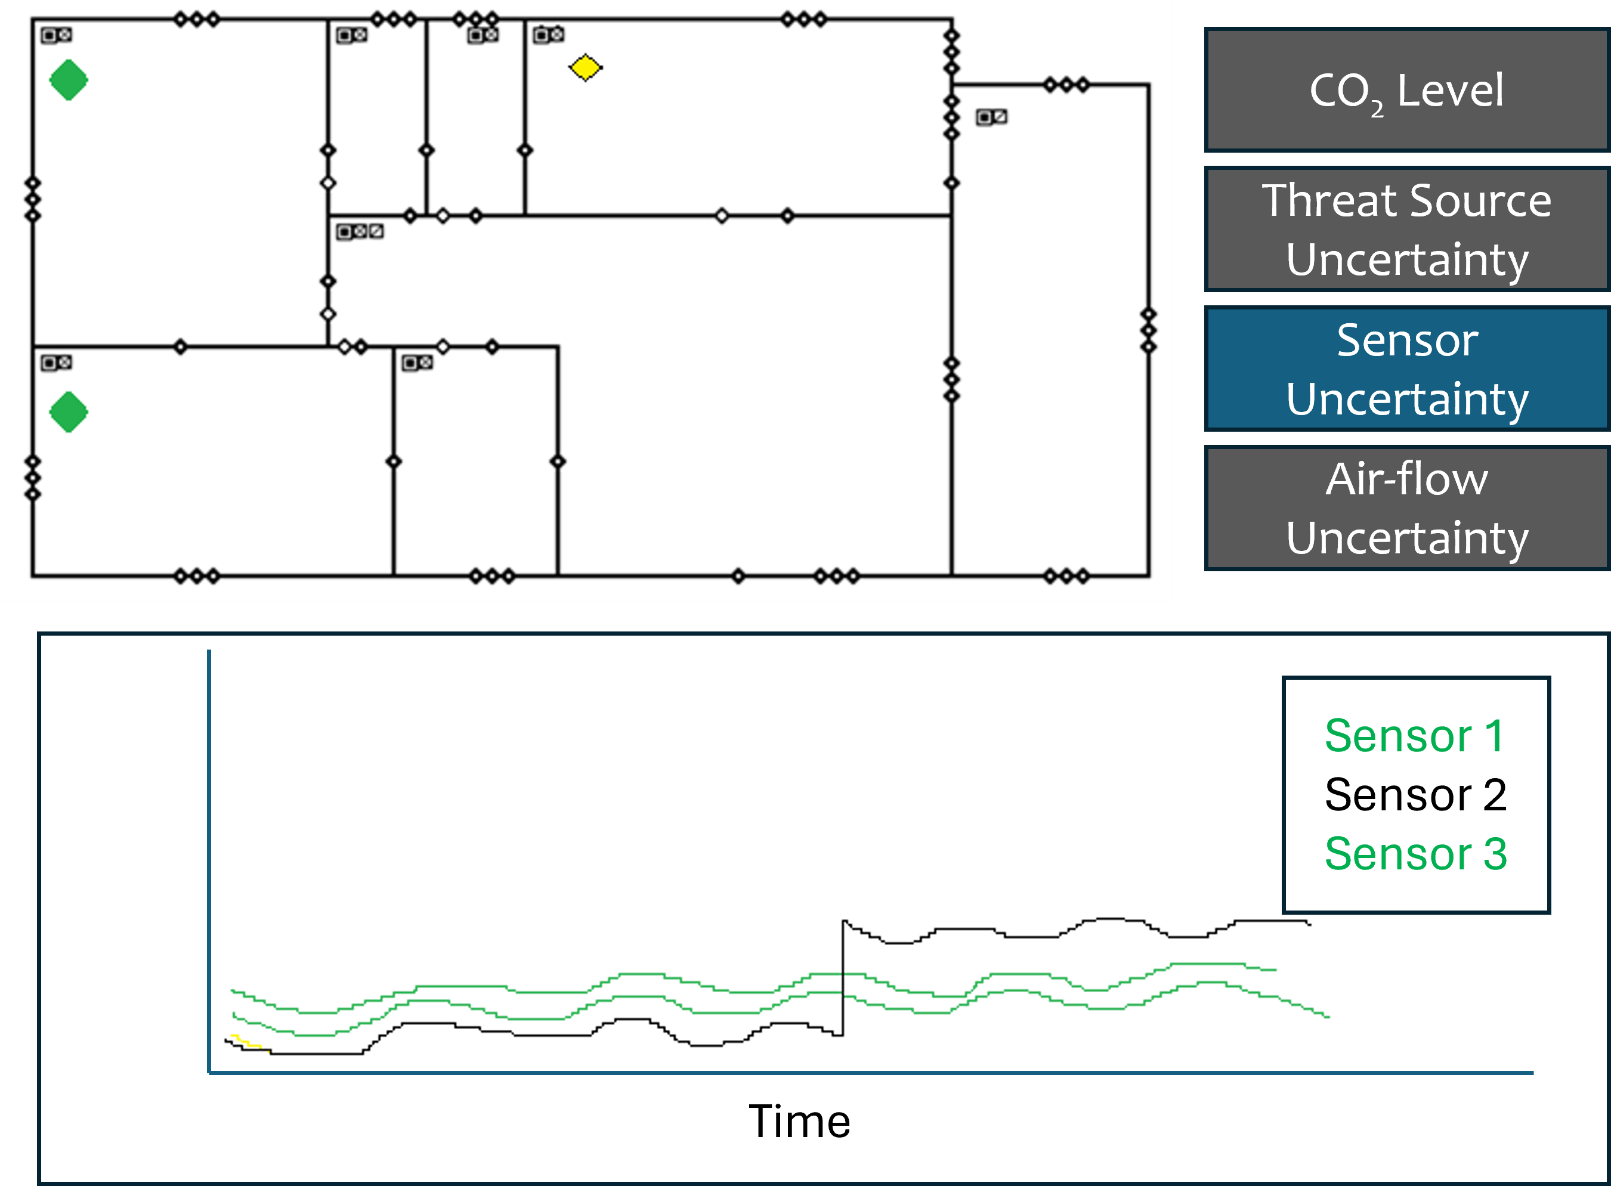
Uncertainty Visualization

Slide 33
Expected Contributions
Formalization of dynamic uncertainty budgeting techniques to attribute, quantify, and track uncertainty over time from sources such as sensor noise, model-form errors, parameter variability, and environmental fluctuations.
Design of a meta-methodology for selecting appropriate uncertainty quantification and sensitivity analysis methods based on system characteristics and validation metrics.
Providing a framework for knowing not just which uncertainties matter, but when they matter

Slide 34
Publications
Geospatial Awareness for Consequence Assessments (GACA) 3D: Adding 3D and Interior Modeling Capabilities to the Countering Weapons of Mass Destruction Modeling Toolkit (Journal of Countering Weapons of Mass Destruction)
Formalized publication following DTRA S&T Conference (2024)
Literature Review of DTs for IAQ applications with/ Uncertainty Quantification for IAQ (Indoor Air, Building and Environment, Journal of Building Performance Simulation)
Dynamic Uncertainty Modeling Methods (Journal of Uncertainty Quantification, Decision Support Systems)
Uncertainty Aware IAQ-DT Case Study (Indoor Air, Building and Environment, Journal of Building Performance Simulation)

Slide 35
Timeline

Slide 36

aseybert@gmu.edu

Slide 37
Back-up Slides

Slide 38
Literature Review Highlights – Digital Twins
DTs evolved from static simulation models to dynamic, data-driven replicas.
Core Technologies: IoT sensors, cloud/edge computing, and AI/machine learning.
Applications: Manufacturing, smart cities, energy management, healthcare.
Challenges: Uncertainty, data integration, high computational costs, standardization, and security issues.

Slide 39
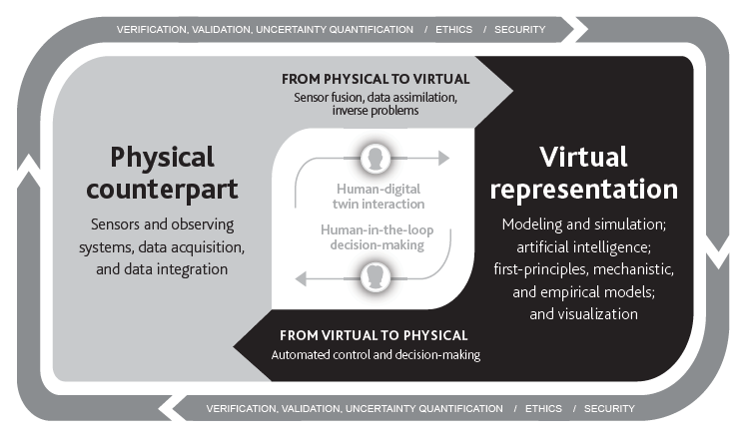
Digital Twin Definitions and Concepts
“A digital twin is a set of virtual information constructs that mimics the structure, context, and behavior of a natural, engineered, or social system (or system-of-systems), is dynamically updated with data from its physical twin, has a predictive capability, and informs decisions that realize value. The bidirectional interaction between the virtual and the physical is central to the digital twin.”
--National Academies of Science, Engineering, and Medicine. Foundational Gaps and Future Directions for Digital Twins. National Academies, 2024.
Components of a Digital Twin
1. Modeling and Simulation to create a virtual representation of a physical counterpart
2. Bi-directional interaction between the virtual and physical
Notes:
\cite{nasemDTFoundations2024}

Slide 40
Digital Twin Components
Physical Counterpart (physical system)
Physical process – dynamic system
Physical environment – influenced by surrounding environment
Virtual Representation
Virtual model/schema – virtual models, simulations, first principles
Virtual process – mirrors physical process
Virtual environment – abstraction of physical environment
Bi-directional Connection
Physical to virtual (P2V) – parameterization (state assessment) of physical counterpart to make DT instance
Virtual to physical (V2P)– automated control, scheduling, sensor steering, decision making

Slide 41
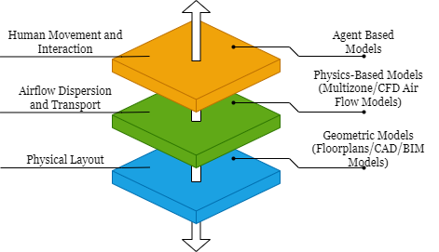
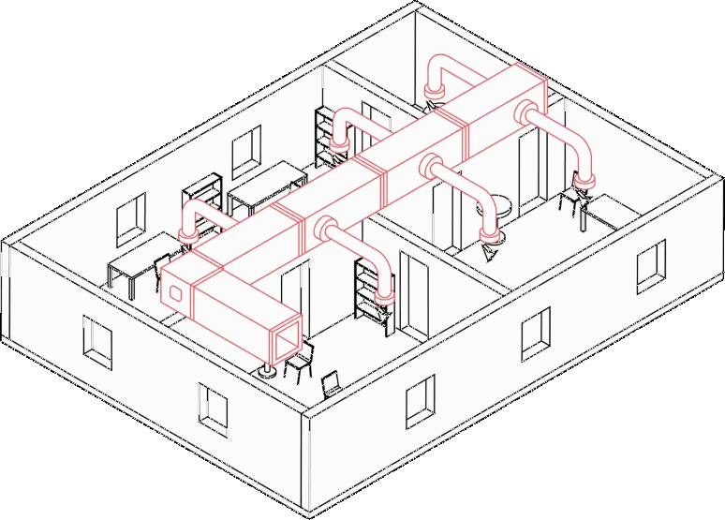
Virtual Representations
Physical Process
Virtual Models

Slide 42
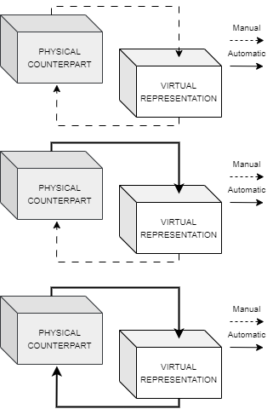
Digital Distinctions
Digital Model –A digital model is a set of virtual information constructs about a proposed, planned, or built physical system that does not use any form of automated data connection between the physical system and virtual constructs
Digital Shadow – A digital shadow is a set of virtual information constructs about a built physical system that includes one or more one-way automated connections between the physical system and the virtual constructs.
Digital Twin – A digital twin is a set of virtual information constructs about a built physical system that includes one or more two-way automated connections between the virtual constructs and the physical system.
Notes:
\cite{kritzingerDTinManufacturingLitReview2018}

Slide 43

Digital Twin Enabling Technologies
IoT Sensors: enable the collection of real-time data from physical assets.
Cloud and Edge Computing: supports scalable and efficient data collection, distribution, and processing.
AI and Machine Learning: enable predictive analytics and decision-making.
Notes:
User generated images with ChatGPT

Slide 44
Digital Twin Application Areas
Manufacturing and Industry 4.0: Optimizes production, reduces downtime, and enables predictive maintenance.
Smart Cities: Helps in urban planning, traffic management, infrastructure monitoring, and disaster response.
Energy and Sustainability: Optimizes energy grids, distribution efficiency, and sustainable resource management.
Healthcare: Creates personalized patient models for diagnostics, treatment planning, and surgical simulations.

Slide 45
Literature Review Highlights – IAQ & STE
IAQ modeling simulates pollutant behavior, airflow, and environmental conditions.
STE quantifies the emission rate, location, and characteristics of indoor pollutants.
Modeling Approaches: Empirical, CFD, and multi-zone models.
Applications: Optimizing ventilation, exposure risk assessment, and emergency response.
Challenges: Uncertainty, data quality, and computational demands.

Slide 46
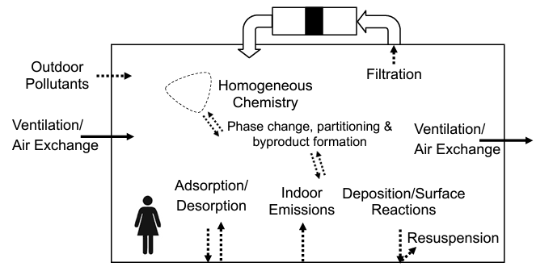
Literature Review-Major Conclusions
Indoor Air Quality (IAQ) Concerns
IAQ is becoming an increasingly critical public health issue due to modern lifestyles and evolving building designs.
Accurately estimating the source term (quantity, rate, and nature of contaminant emissions) is essential for:
Effective ventilation design
Exposure assessment
Risk mitigation
Traditional estimation methods face uncertainties because of:
Variable contaminant emission profiles
Complex indoor and outdoor environments
Sensor inaccuracies
Dynamic occupant behavior
Notes:
\cite{stephensLecture2017}

Slide 47
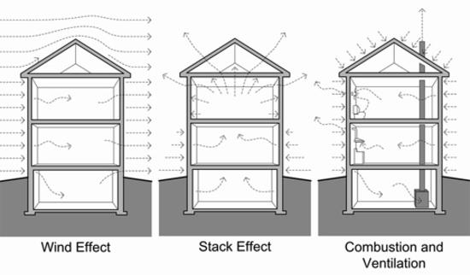
Air Flow Basics for IAQ Modeling
Air Flow
Pressure Difference
Continuous Path
Pressure Difference
Wind
Stack
Mechanical Drivers
Notes:
\cite{straubeAirFlow2007}

Slide 48
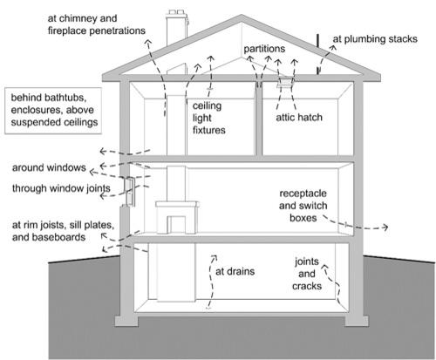
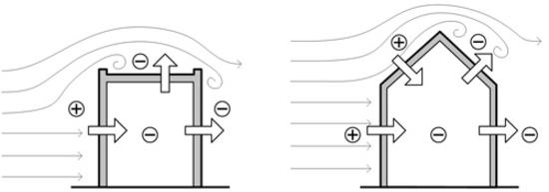
Wind and Air Flow Leakage
Wind
Leakage/infiltration (interior and exterior)
Notes:
\cite{straubeAirFlow2007}

Slide 49
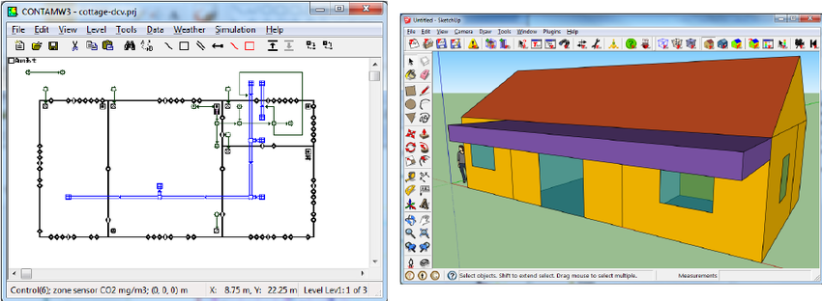
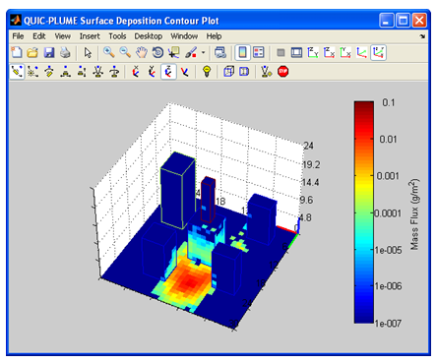
IAQ Modeling Approaches
Empirical Modeling: Empirical modeling approaches involve using observed data and statistical techniques to establish relationships between indoor pollutant levels and influencing factors.
Multi-zone Models: Multi-zone models simplify indoor spaces into interconnected zones, balancing efficiency and accuracy for large-scale buildings.
Computational Fluid Dynamics (CFD): CFD modeling provides high-resolution simulations of airflow and pollutant transport but requires significant building-level-detail and computational resources.
CONTAM SketchPad with SketchUp Building
QUIC Dispersion Modeling System
Notes:
\cite{quicLANL}
\cite{contam2015}
\cite{dolsCONTAM2014}

Slide 50
3D and Indoor CBRN Modeling Tools
FEMA Urban/Structural CBRN Modeling Tools
3D CBRN Contamination Transport
AEOLOS
Contaminant Transport Analyst (CT-Analyst)
Quick Urban & Industrial Complex (QUIC) Dispersion Modeling System
Indoor CBRN Contamination Transport
CONTAM (within HPAC)
Integrated Indoor-Outdoor Air Calculator (IIOAC)
\cite{femaPlanning}
\cite{EPACBRNModelingPrograms2020}

Slide 51
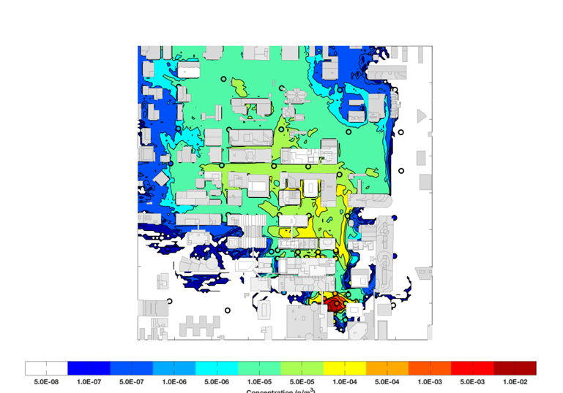
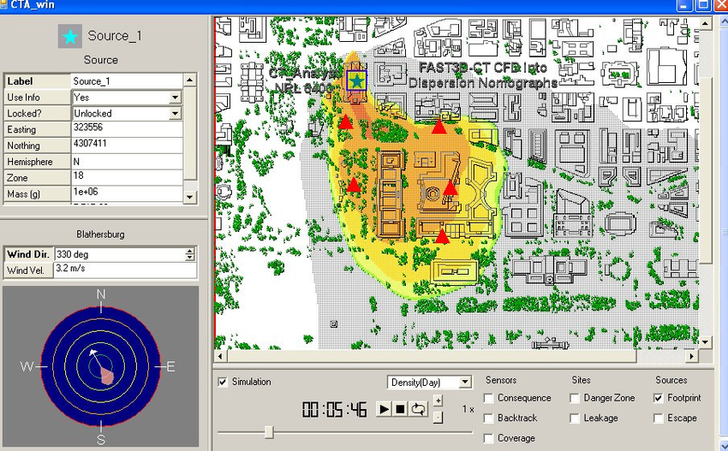
3D CBRN Modeling Tools
AEOLOS—Lawerence Livermore National Labs \cite{aeolusWeb} \cite{GowardhanAeolus2017}
CT-Analyst—Naval Research Labs \cite{mosesCTAnalyst2014} \cite{kijewskiCT2009}
QUIC Dispersion Modeling System – Los Alamos National Labs \cite{quicLANL}
AEOLUS Simulation Results
CT-Analyst GUI with Results
QUIC Dispersion Modeling System

Slide 52
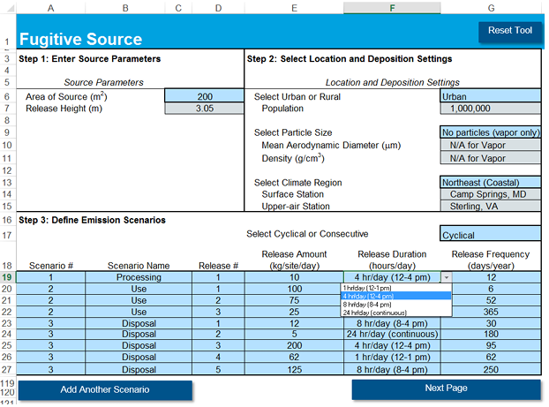
Indoor Modeling Tools
CONTAM
A multizone computer program for indoor air quality and ventilation analysis, designed to assist in evaluating:
airflows: including infiltration, exfiltration, and air movement between rooms
contaminant concentrations: tracking the spread of airborne contaminants carried by these airflows
personal exposure: predicting occupants' exposure to airborne contaminants for use in risk assessment. \cite{contam2015} \cite{dolsCONTAM2014}
CONTAM SketchPad with SketchUp Building
Integrated Indoor-Outdoor Air Calculator (IIOAC)
An Excel-based tool designed to estimate air concentrations, both indoors and outdoors, as well as particle deposition over distance from chemical air releases. IIOAC accommodates various meteorological stations, local land cover, release durations, particle or vapor scenarios, urban or rural environments, and different source types. Releases can originate from facilities (such as stacks, incinerators, or fugitive emissions), as well as from area soil or water sources. \cite{iioac}
IIOAC GUI \cite{iioac}

Slide 53
IAQ-DT Frameworks
Evolution of Digital Twin Technologies for IAQ
Initial DTs focused on energy and equipment; IAQ attention grew post-2018.
COVID-19 accelerated IAQ-DT research for airborne contaminant tracking.
Recent studies use BIM, IoT, and ML for IAQ in hospitals, libraries, and event spaces.
Key Challenges in IAQ Digital Twins
Model Complexity vs. Speed: CFD is accurate but slow; simpler models trade detail for speed.
Sensor Data Issues: Quality, interoperability, standardization, and calibration problems.
Lack of Standards: No uniform metrics or validation protocols for IAQ-DTs.
Organizational Barriers: High deployment cost, technical skill gaps, and cybersecurity concerns.
Control System Integration: Difficulty interfacing with legacy HVAC systems for automated mitigation.

Slide 54
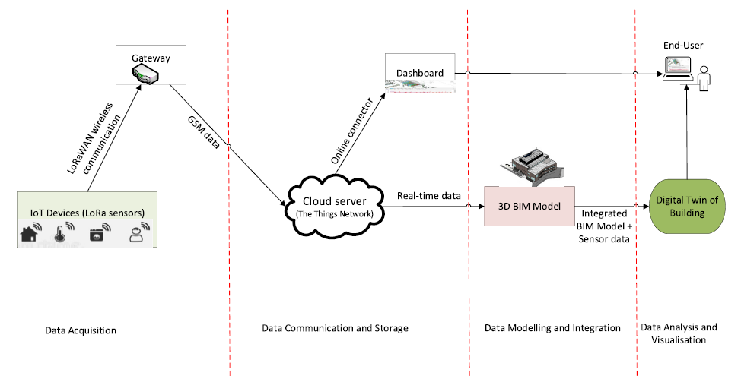
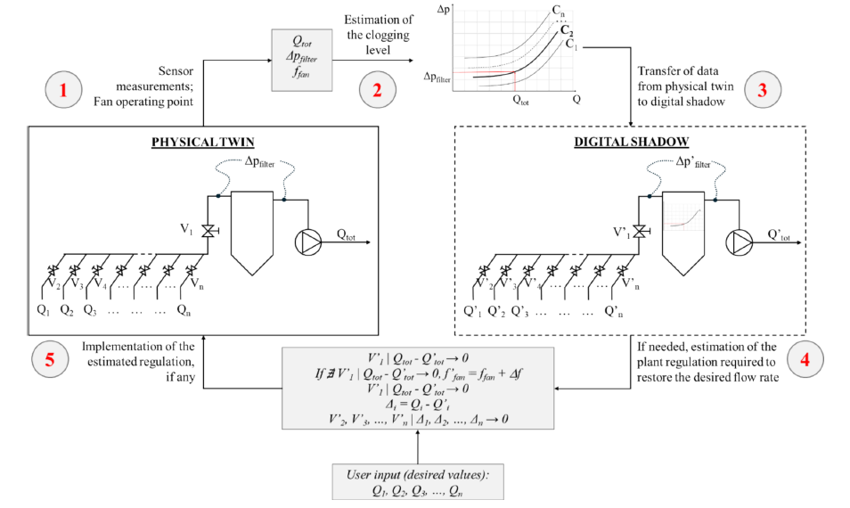
IAQ-DT Frameworks in the Literature
Opoku et al. explore the integration of BIM and IoT sensors to develop a DT system for monitoring indoor conditions in a university library \cite{opokuIAQ-DT2024}. Using a four-layered system architecture (data acquisition, data communication, data and model integration, and data analysis and visualization), their IAQ-DT framework captures real-time environmental data (temperature, humidity, air quality, lighting) and visualizes it in a BIM-based model to aid facility management.
opokuIAQ-DT2024_pg4
solariDTAirFilter2024_pg8

Slide 55
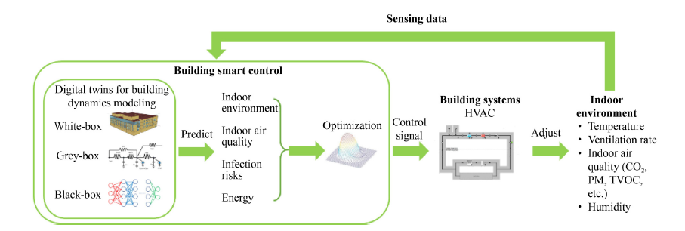
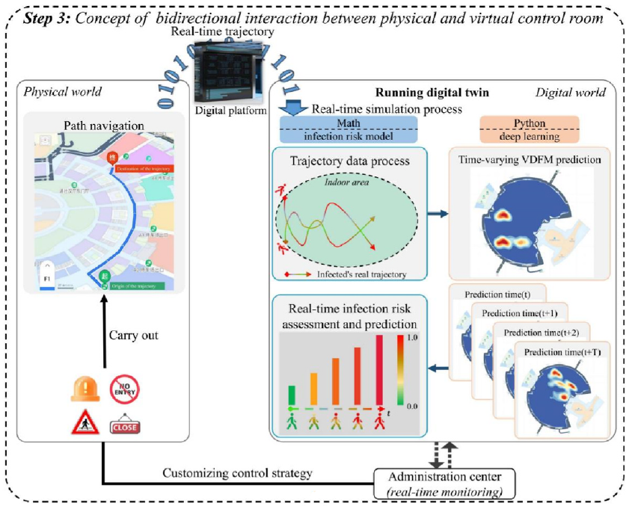
IAQ-DT Frameworks in the Literature
Cai et al. provide framework for using sensors with machine learning algorithms for indoor air quality (IAQ) modeling \cite{caiDTforIAQ2023}. The study explores how DT technology can integrate IoT-based sensors with data-driven analytics to monitor, predict, and optimize indoor environmental conditions.
caiDTforIAQ2023_pg11
Wang et al. introduce a DT framework for integrating pedestrian movement with a time-varying virus density field map to better understand infectious disease spread in indoor environments \cite{wangDT-IAQTrajectoryApproach2024}.
wangDT-IAQTrajectoryApproach2024_pg3

Slide 56
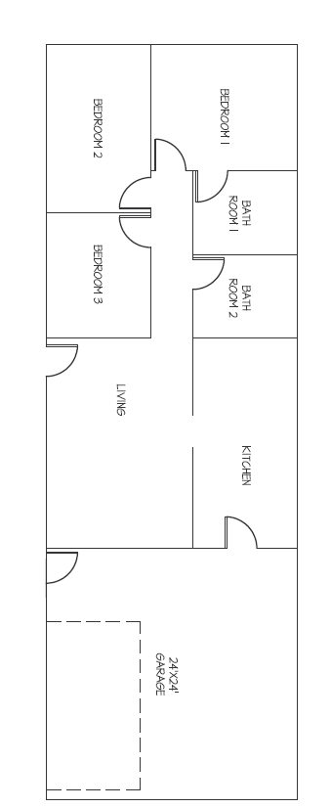
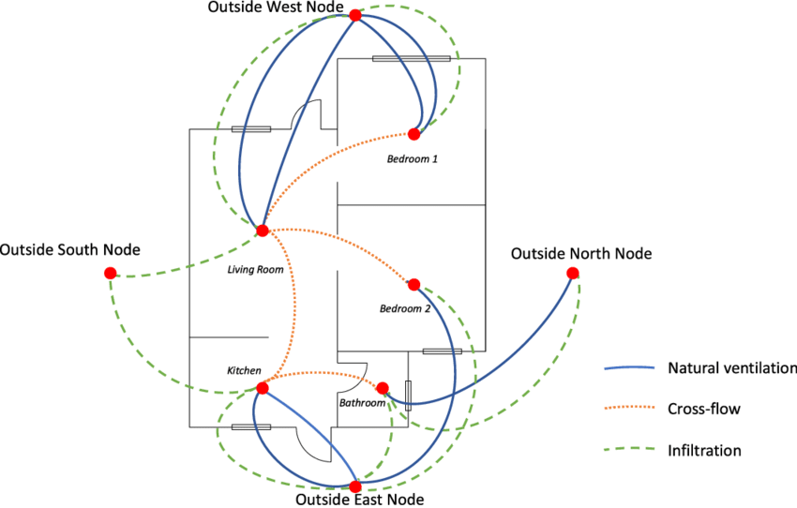
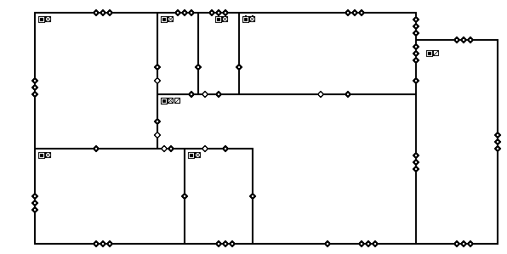
CONTAM Model from Floorplan

Slide 57
Types of Uncertainty
Aleatoric Uncertainty: Represents inherent randomness in system behavior (e.g., natural variability in environmental conditions).
Epistemic Uncertainty: Results from incomplete knowledge or data (e.g., modeling assumptions, lack of measurements).

Slide 58
UQ Methods
Frequentist Tools: Include confidence intervals, bootstrapping, and error propagation formulas; often used in deterministic models.
Bayesian Methods: Offer probabilistic modeling of unknowns, allow updates as new data becomes available; suitable for adaptive DTs.
Method Selection: Depends on problem context, data availability, and desired confidence in predictions.

Slide 59
Sensitivity Analysis
Objective: Identify which input parameters most significantly affect output uncertainty.
Local Methods: Examine changes around a fixed input (e.g., gradients).
Global Methods: Quantify input influence across full input space (e.g., Sobol' indices, Morris method).
Applications: Sensor placement, parameter prioritization, and model simplification.

Slide 60
Monte Carlo & Propagation
Monte Carlo Simulation: Uses random sampling to estimate output variability.
Uncertainty Propagation: Translates input uncertainty into output distributions.
Advantages: Model-agnostic, supports nonlinear and high-dimensional systems.
Limitations: Computationally intensive, often mitigated by surrogate models.

Slide 61
UQ for Dynamical Systems
Challenges: Time-dependent data updates and evolving system states require dynamic models.
Methods: Kalman filters, particle filters, stochastic differential equations track uncertainty over time.
Importance: Enables real-time decision support under changing conditions.

Slide 62
UQ in DT Systems
Parameter Uncertainty: Affects calibration accuracy—arises from sensor drift, input ranges, or structural assumptions.
Model-System Uncertainty: Includes discrepancies between modeled behavior and real-world system due to simplifications or unknown dynamics.
Impact: These uncertainties reduce trust in DT outputs and must be continuously assessed.

Slide 63
Challenges and Future Directions
Lack of Standardized UQ Integration: Few DT systems embed UQ as a core feature.
Real-Time Constraints: Many UQ methods are not computationally efficient for live systems.
Explainability: Users need interpretable outputs showing which sources of uncertainty dominate.
Future Research: Focus on lightweight UQ, explainable AI for DT, and dynamic validation metrics.

Slide 64
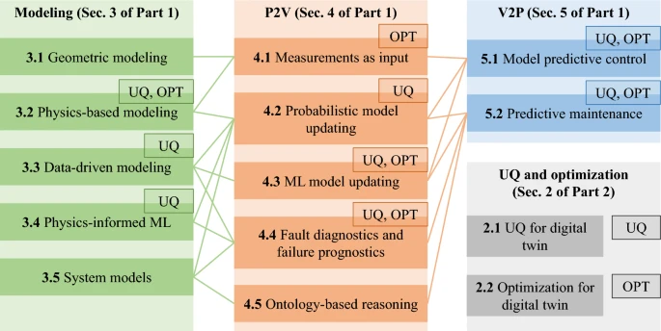
A Comprehensive Review of Digital Twins
Physical System
P2V
Modeling/Virtual
V2P
Thelen, A., Zhang, X., Fink, O. et al. A comprehensive review of digital twin — part 1: modeling and twinning enabling technologies. Struct Multidisc Optim 65, 354 (2022). https://doi.org/10.1007/s00158-022-03425-4 (139 Citation)
Thelen, A., Zhang, X., Fink, O. et al. A comprehensive review of digital twin—part 2: roles of uncertainty quantification and optimization, a battery digital twin, and perspectives. Struct Multidisc Optim 66, 1 (2023). https://doi.org/10.1007/s00158-022-03410-x (58 citations)

Slide 65
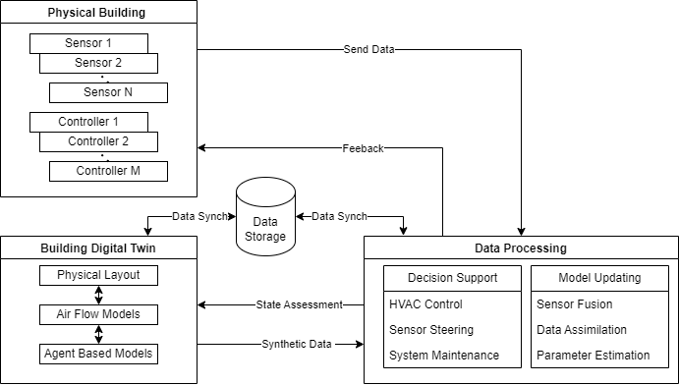
IAQ-DT Framework

Slide 66
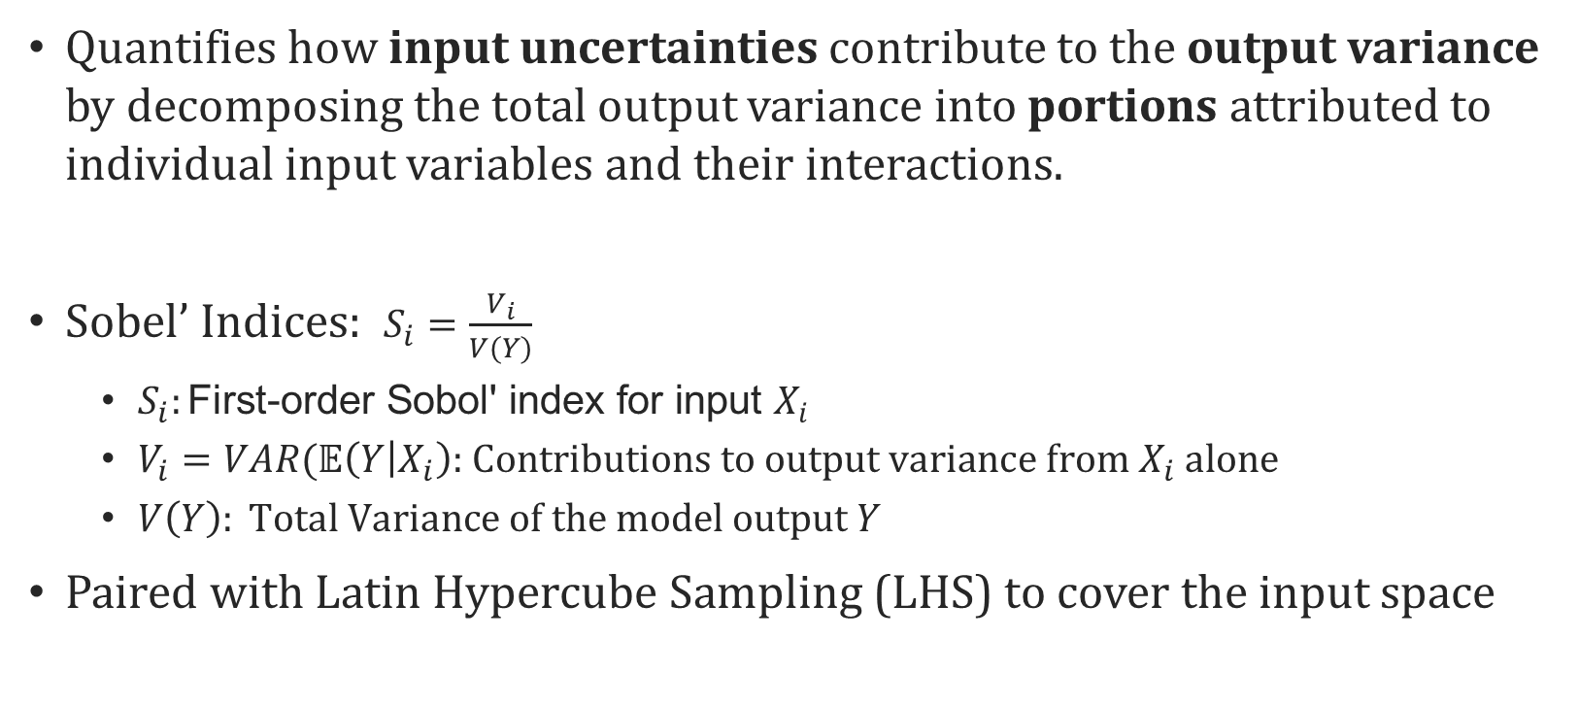
Variance Based Sensitivity Analysis
Quantifies how input uncertainties contribute to the output variance by decomposing the total output variance into portions attributed to individual input variables and their interactions.
Sobel’ Indices: $S_{i}=\frac{V_{i}}{V(Y)}$
$S_{i}:\text{First}\text{−}\text{order} \text{Sobol}\text{′ }\text{index} \text{for} \text{input} X_{i}\text{​}$
$V_{i}=VAR(𝔼\left(Y | X_{i}\right) \text{: }\text{Contributions} \text{to} \text{output} \text{variance} \text{from} X_{i} \text{alone}$
$V\left(Y\right): \text{Total} \text{Variance} \text{of} \text{the} \text{model} \text{output} Y$
Paired with Latin Hypercube Sampling (LHS) to cover the input space

Slide 67
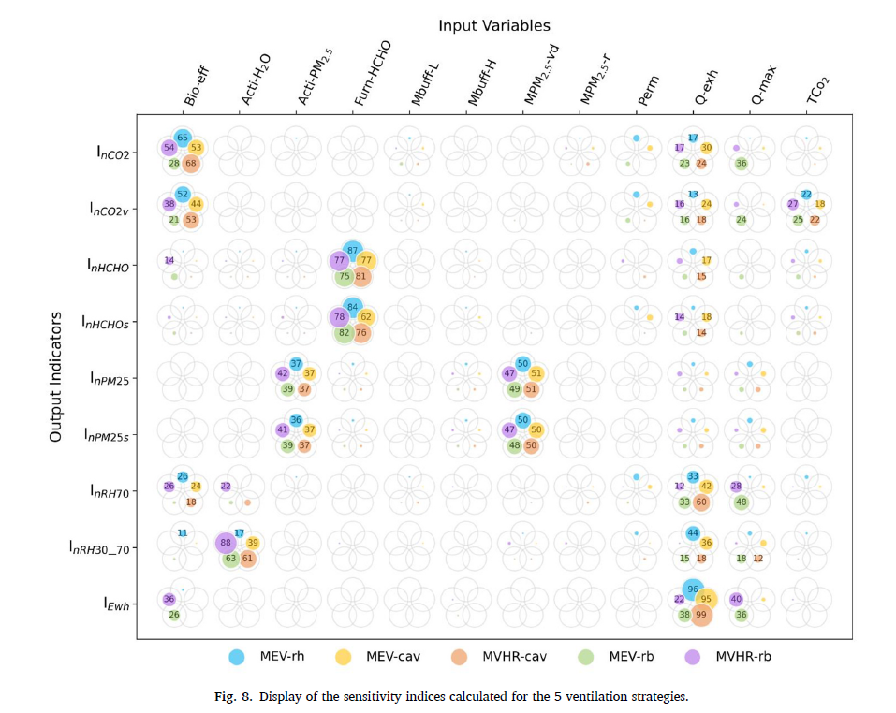
Sensitivity Analysis
Poirier et al. (2024) Conducted sensitivity Analysis of ventilation strategies
Random Balance Design-Fourier Amplitude Sensitivity Test (RBD-FAST)
Computational efficient
Identifies which outputs are most sensitive to which inputs
Allows for comparison across strategies
Demonstrated RBD-FAST with CONTAM IAQ modeling
Notes:
\cite{poirierUQforIAQ2024}

Slide 68
Sensitivity Analysis to Reduce Uncertainty
Pivowar et al. (2024) SA implementation to optimize sensor placement based on performance and uncertainty \cite{PivovarDTOpt2024}
Cao et al. (2024) use SA for virtual model selection and robust assessment of mine ventilation \cite{caoDTUQModels2024}

Slide 69
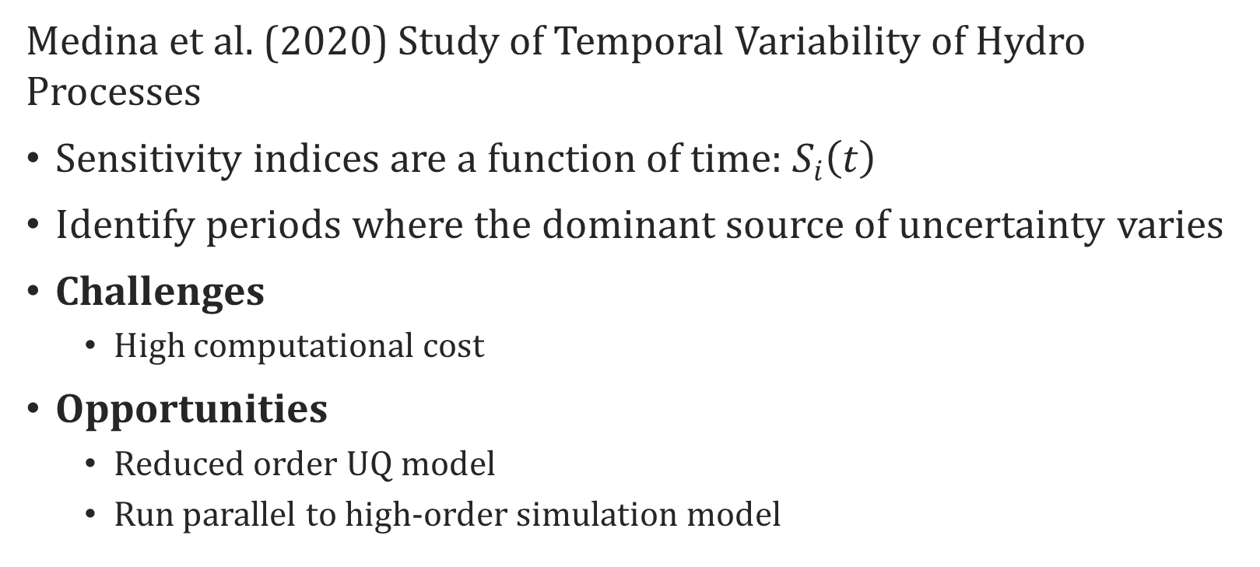
Time Varying Sensitivity Analysis
Medina et al. (2020) Study of Temporal Variability of Hydro Processes
Sensitivity indices are a function of time: $S_{i}\left(t\right)$
Identify periods where the dominant source of uncertainty varies
Challenges
High computational cost
Opportunities
Reduced order UQ model
Run parallel to high-order simulation model
Notes:
Medina, Y.; Muñoz, E. A Simple Time-Varying Sensitivity Analysis (TVSA) for Assessment of Temporal Variability of Hydrological Processes. Water 2020, 12, 2463. https://doi.org/10.3390/w12092463

Slide 70
Multi-simulation Experimentation
Default.prj
Model permutations
Perm_1.prj
Perm_2.prj
Perm_n.prj
BatchFile
Results
Default_SrcOa_VentWthOnly.prj
Default_SrcOa_VentFan1.prj
Default_SrcOa_VentFan2.prj
Default_SrcOa_VentWthFan1.prj
Default_SrcInt_VentWthOnly.prj
Default_SrcInt_VentFan1.prj
Default_SrcInt_VentFan2.prj
Default_SrcInt_VentWthFan1.prj
Default_SrcBoth_VentWthOnly.prj
Default_SrcBoth_VentFan1.prj
Default_SrcBoth_VentFan2.prj
Default_SrcBoth_VentWthFan1.prj
Set 1: Source related states
State Names | TAG | SrcOa | SrcInt | SrcBoth
Change 1: Outdoor CTM file | $(SOURCE 1) | Default.ctm | null | Default.ctm
Change 2: Indoor Burst source | $(SOURCE 2) | 0 | 1 | 1
Set 2: Ventilation related states
State Name | TAG | VentWthOnly | VentFan1 | VentFan2 | VentWthFan1
Change 1: Fan flow multiplier | $(VENT 1) | 0 | 1 | 2 | 1
Change 2: WTH file | $(VENT 2) | Default.wth | null | null | Default.wth

Slide 71
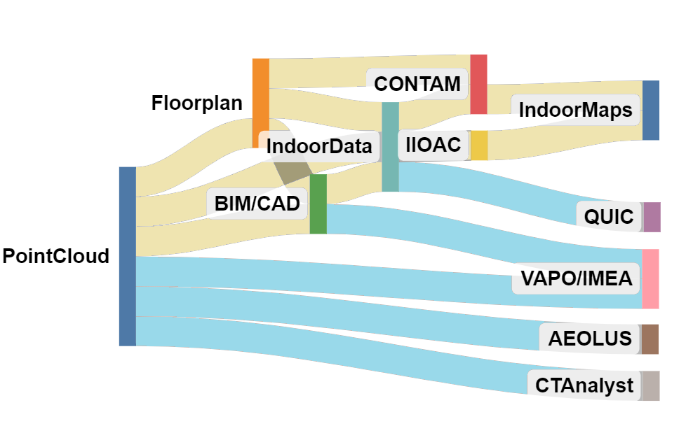
Conference Participation
DTRA/JSTO Science and Technology Conference 2024
(December 2-5, 2024)
Presented research on a survey of methods, tools, and capabilities to develop 3D and indoor models for CBRN modeling. This work included a mapping of 3D and indoor data sources to DoD specific CBRN modeling programs. Mapping relationships included a survey the tools and methods for conversion.
Indirect Translation
Direct Ingestion
Potential Conferences
SAIM UQ Conference (Spring 2026)
SAIM/CAIMS Annual Meeting (Summer, 2026)
VVUQ (Spring, 2026)
Annual Modeling and Simulation (Summer, 2026)
George Mason Atmospheric Transport and Dispersion Modeling (2026)

Slide 72
Follow-on Work
Advanced Visualization Techniques for Uncertainty Aware Digital Twins
Agent Based Model integration in DT (with case study)
Case Study of “Model Switching”
1D CONTAM for specific zones
CFD-0 CONTAM for specific zones

Slide 73
US Army Advanced Civil Schooling Program
AY | AY2023 |  | AY2024 |  |  | AY2025 |  |  |  | AY2026 |  |  | AY2027 |  |  | AY2028
CY | 2022 | 2023 |  |  | 2024 |  |  | 2025 |  |  |  | 2026 |  |  | 2027 |  |  | 2028
 | Self Funded |  |  | Advanced Civil Schooling Funding (Resident) |  |  |  |  |  |  |  |  |  | Advanced Civil Schooling Funding (Part Time)
 | Fall | Spring | Summer | Fall | Spring | Summer | Fall | Spring |  | Summer | Fall | Spring | Summer | Fall | Spring | Summer | Fall | Spring
 | CSI 501 | CSI 674 |  | CSI 695 | CSI 703 | CSI998 | CSI 998 | CSI 998 |  | CSI 998 | CSI 999 | CSI 999
 |  |  |  | CSI 672 | CSI678 |  | CSI 998 | CSI 998 |  |  | CSI 999 | CSI 999
 |  |  |  | CSI777 | GGS692 |  | GGS680 | CSI758
 |  |  |  |  |  |  |  |  | Comp exams
 | Core | 6 |  | CSI 695 | Scientific Databases
 | Emphasis | 18 | ROC | CSI 703 | Scientific and Statistical Visualization
 | Elective | 24 | 23
 | Research | 24 |  | CSI 501 | Introduction to Scientific Programming
 | Min 999 | 6 |  | CSI 674 | Bayesian Inference and Decision Theory
 |  |  |  | CSI 678 | Time Series Analysis and Forecasting
 |  |  |  | CSI 672 | Statistical Inference
 |  |  |  | CSI 777 | Principles of Knowledge Mining
 |  |  |  | CSI 758 | Visualization and Modeling Complex Systems

